Slide 1
Graphs

Slide 2
Basic concepts
A graph is
a collection of nodes, called vertices,
and a collection of segments, called lines, connecting pairs of vertices
A directed graph, or digraph for short is
a graph in which each line has a direction (arrow head) to its successor
The lines in a directed graph are known as arcs
The flow along the arcs between two vertices can follow only the indicated direction
An undirected graph is
a graph in which there is no direction on any of the lines, which are known as edges
The flow between two vertices can go in either direction

Slide 3
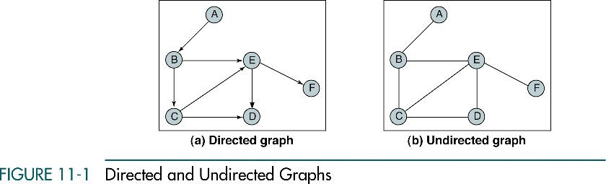

Slide 4
Basic concepts
A path is a sequence of vertices in which each vertex is adjacent to the next one
In Fig.11-1, (A, B, C, E) is one path
(A, B, E, F) is another path
Two vertices in a graph are said to be adjacent vertices (neighbors) if there is a path of length 1 connecting them
In Fig.11-1(a), B is adjacent to A, E is not adjacent to D; D is adjacent to E
In Fig.11-1(b), E and D are adjacent, but D and F are not

Slide 5
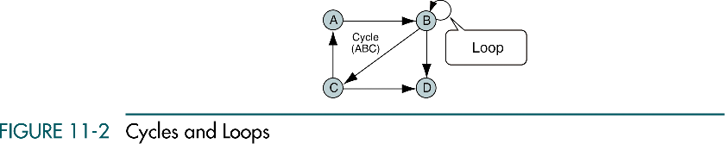
Basic concepts
A cycle is a path consisting of at least three vertices that starts and ends with the same vertex
In fig. 11-1(a), no cycle
In fig. 11-1(b), B, C, D, E, B is a cycle
A loop is a special case of a cycle in which a single arc begins and ends with the same vertex

Slide 6
Basic concepts
Two vertices are said to be connected if there is a path between them
A graph is said to be connected if, ignoring direction, there is a path from any vertex to any other vertex
A directed graph is strongly connected if there is a path from each vertex to every other vertex
A directed graph is weakly connected if at least two vertices are not connected
A graph is disjoint if it is not connected

Slide 7
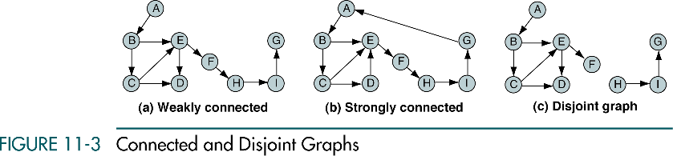

Slide 8
Basic concepts
The degree of a vertex is the number of lines incident to it
The outdegree of a vertex in a digraph is the number of arcs leaving the vertex
The indegree is the number of arcs entering the vertex
In Fig. 11-3(a), the degree of vertex B is 3 and E is 4
The indegree of vertex B is 1 and its outdegree is 2
Tree
Is a graph in which each vertex has only one predecessor; however, a graph is not a tree

Slide 9
Operations
The six primitive graph operations needed to maintain a graph
Insert Vertex
Delete Vertex
Add Edge
Delete Edge
Find Vertex
Traverse Graph

Slide 10
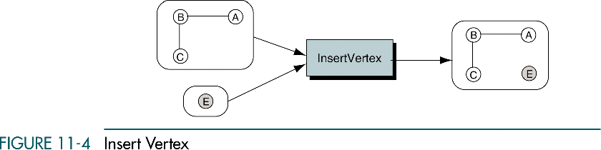
Insert Vertex
Adds a new vertex to a graph
When a vertex is added, it is disjoint (it is not connected to any other vertices)

Slide 11
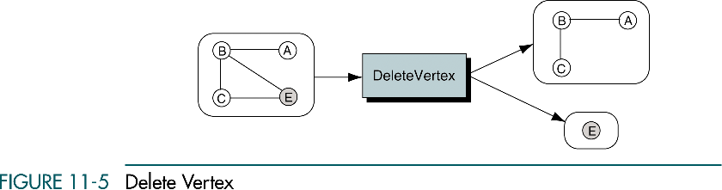
Delete Vertex
Removes a vertex from the graph
When a vertex is deleted, all connecting edges are also removed

Slide 12
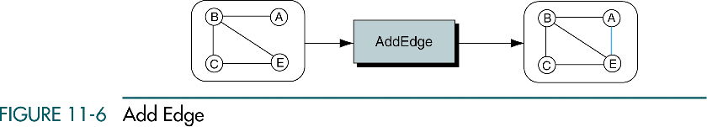
Add Edge
Adds an edge connects a vertex to a destination vertex
To add an edge, two vertices must be specified
If the graph is a digraph, one of the vertices must be specified as the source and one as the destination
Ex) Adding an edge, {A, E}

Slide 13
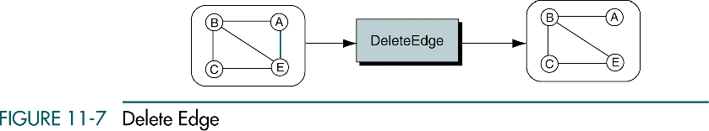
Delete Edge
Removes one edge from a graph
Ex) delete the edge {A, E}

Slide 14
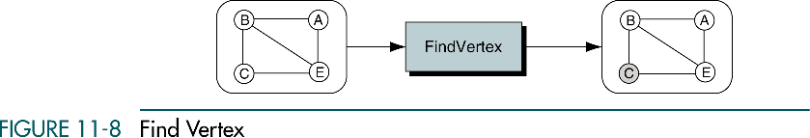
Find Vertex
Traverses a graph, looking for a specified vertex
If the vertex is found, its data are returned
If it is not found, an error is returned

Slide 15
Traverse Graph
There is at least one application that requires that all vertices in a given graph be visited
Because a vertex in a graph can have multiple parents, the traversal of a graph presents some problems not found in the traversal of linear lists and trees
Specifically, we must somehow assure that we process the data in each vertex only once
Because there are multiple paths to a vertex, it is possible that we can arrive at it from more than one direction as we traverse the graph
The traditional solution to this problem is to include a visited flag et each vertex

Slide 16
Traverse Graph
Before the traversal, the visited flag in each vertex to off
Then, as we traverse the graph, we set the visited flag to on to indicate that the data have been processed
Two standard graph traversals:
Depth-first
Breadth-first

Slide 17
Depth-first traversal
We process all of a vertex’s descendents before we move to an adjacent vertex
Starts by processing the first vertex of the graph
After processing the first vertex, we select any vertex adjacent to the first vertex and process it
As we process each vertex, we select an adjacent vertex until we reach a vertex with no adjacent entries
We then back out of the structure, processing adjacent vertices as we go
This logic requires a stack (or recursion) to complete the traversal

Slide 18
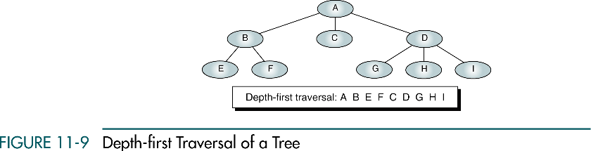

Slide 19
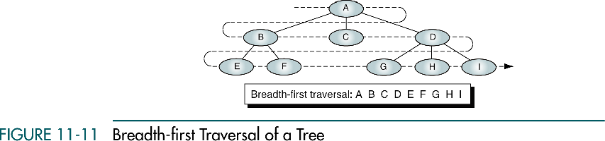
Breadth-first traversal
We process all adjacent vertices of a vertex before going to the next level

Slide 20
Breadth-first traversal
We begin by picking a starting vertex and after processing it, we process all of its adjacent vertices
When all of the adjacent vertices have been processed, we pick the first adjacent vertex and process all of its vertices, then the second adjacent vertex and process all of its vertices, and so forth until we are finished
As we process each vertex, we place all of its adjacent vertices in the queue
Then, to select the next vertex to be processed, dequeue a vertex and process it

Slide 21
Graph Storage Structures
To represent a graph, we need to store two sets:
The first set represents the vertices of the graph
The second set represents the edges or arcs.
The two most common structures used to store these sets are arrays and linked lists
Adjacency Matrix
Adjacency List

Slide 22
Adjacency Matrix
The adjacency matrix uses
A vector (one-dimensional array) for the vertices
A matrix (two-dimensional array) to store the edges
If two vertices are adjacent, that is
If there is an edge between them, The matrix intersect has a value of 1
If there is no edge between them, the intersect is set to 0

Slide 23
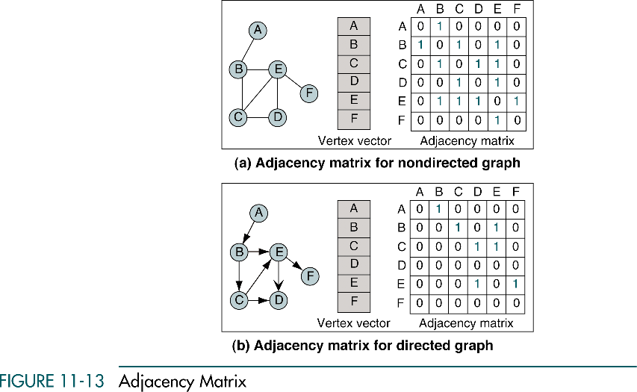

Slide 24
Adjacency Matrix
A major limitation
The size of the graph (the number of vertices) must be known before the program starts
Another limitation
Only one edge can be stored between any two vertices
Some network structures require multiple lines between vertices

Slide 25
Adjacency List
The adjacency list uses
A two-dimensional ragged array to store the edges
The vertex list is a singly-linked list
Depending on the application, it could also be implemented using doubly-linked lists or circularly-linked list
The pointer at the left of the list links the vertex entries
The pointer at the right in the vertex is a head pointer to a linked list of edges

Slide 26
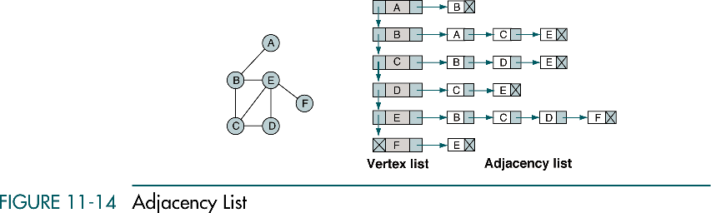

Slide 27
Graph Algorithms
In this section we develop a minimum set of algorithms that are needed to create and maintain a directed graph
Create Graph
Insert Vertex
Delete Vertex
Insert Arc
Delete Arc
Retrieve Vertex
Depth-first Traversal
Breadth-first Traversal
Destroy Graph
Before discussing the algorithms, we need to design the data structure. The most flexible structure is the adjacency list implemented as a singly linked list.

Slide 28
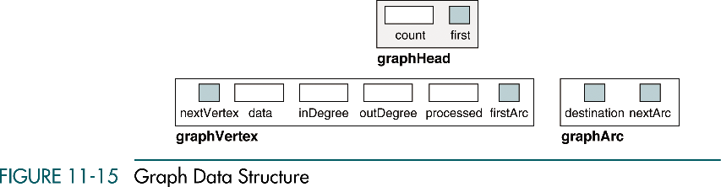
The number of vertices
Metadata about the list
Used only for traversals. It indicates the data in a vertex are waiting to be processed or have already been processed

Slide 29
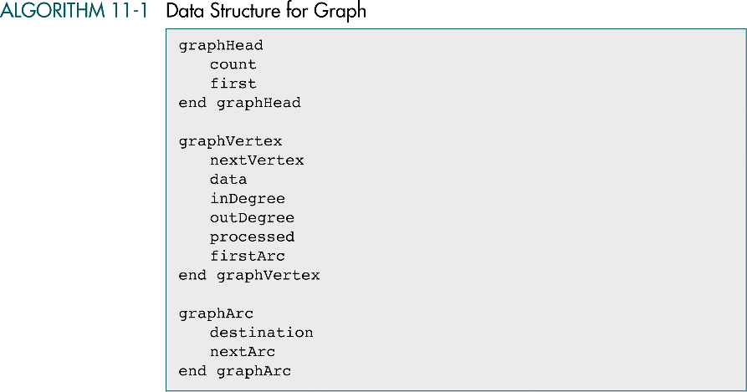

Slide 30
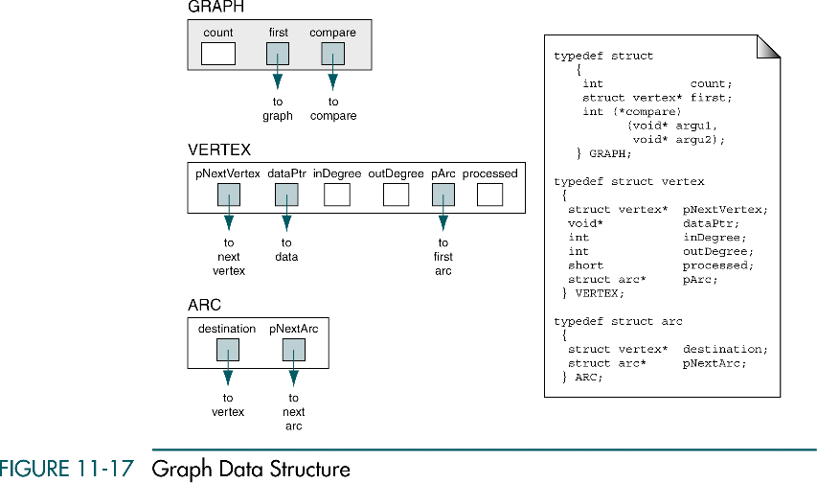

Slide 31
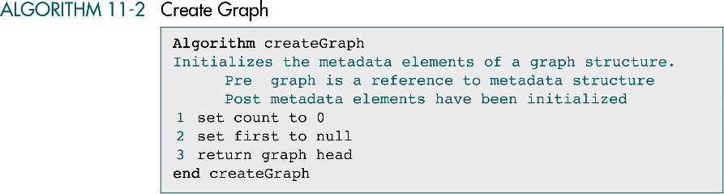
Create Graph
initializes the metadata elements for a graph head structure

Slide 32
Insert Vertex
Adds a disjoint (unconnected) vertex to the graph
The arcs associated with the vertex must be inserted separately

Slide 33
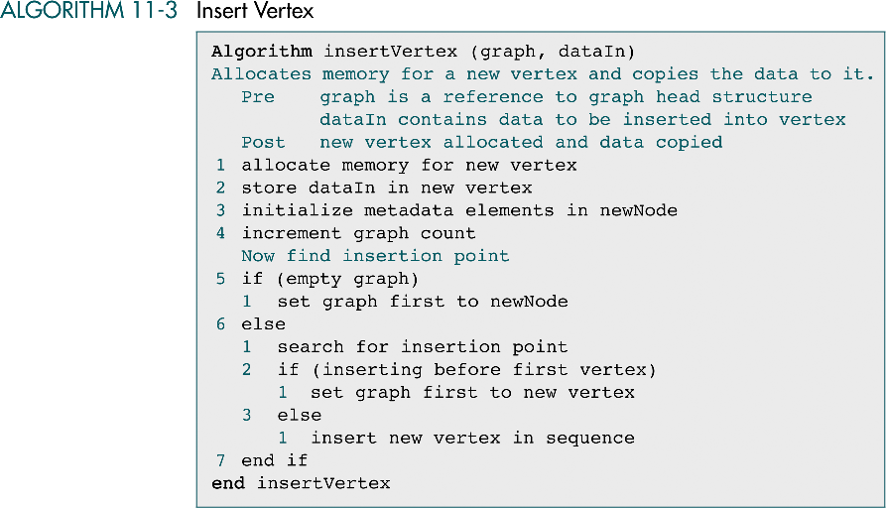

Slide 34
Delete Vertex
To delete a vertex we have to find it
We need to make sure that it is disjoint
We need to ensure that there are no arcs leaving or entering the vertex
If there are, we reject the deletion

Slide 35
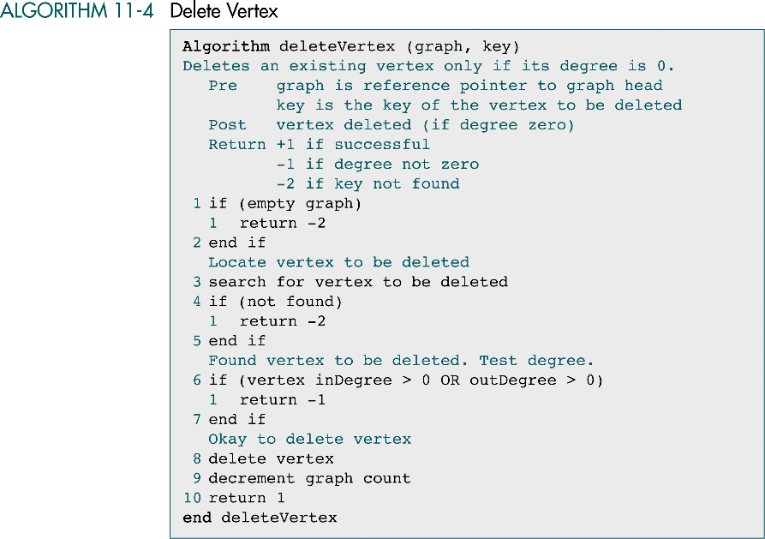

Slide 36
Insert Arc
Requires two points in the graph:
The source vertex (from)
The destination vertex (to)

Slide 37
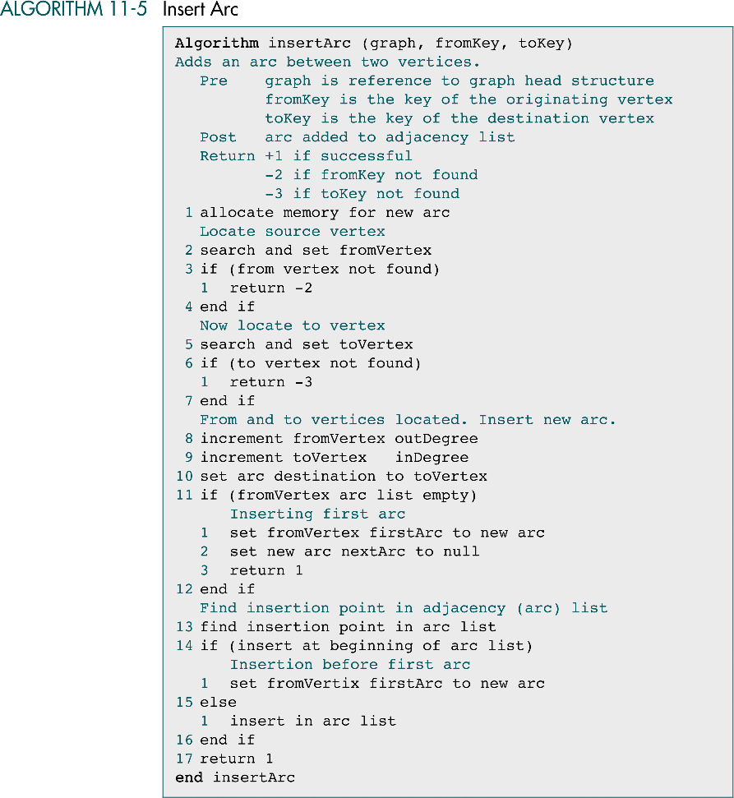

Slide 38
(continued)

Slide 39
Delete Arc
Removes one arc from the adjacency list
To identify an arc, we need two vertices (which are identified by their key)

Slide 40
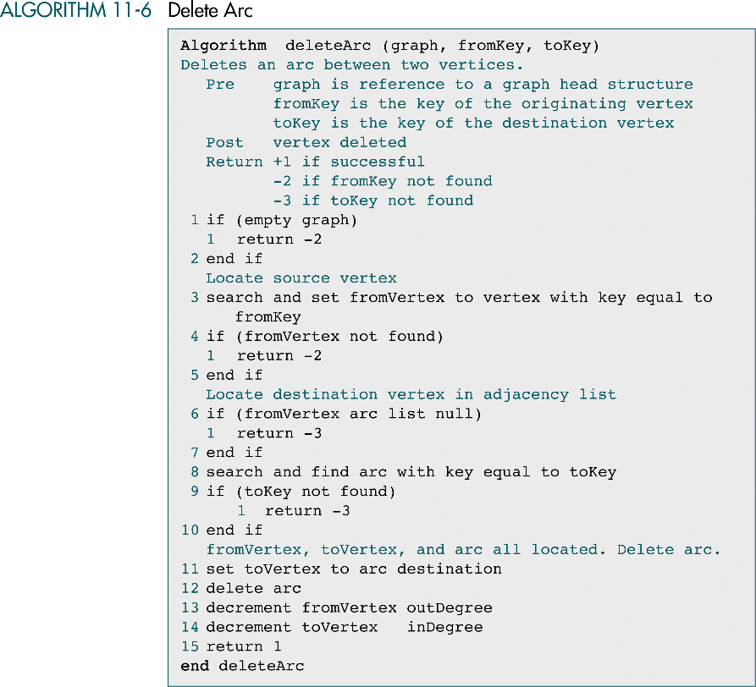

Slide 41
(continued)

Slide 42
Retrieve Vertex
Returns the data stored in a vertex

Slide 43
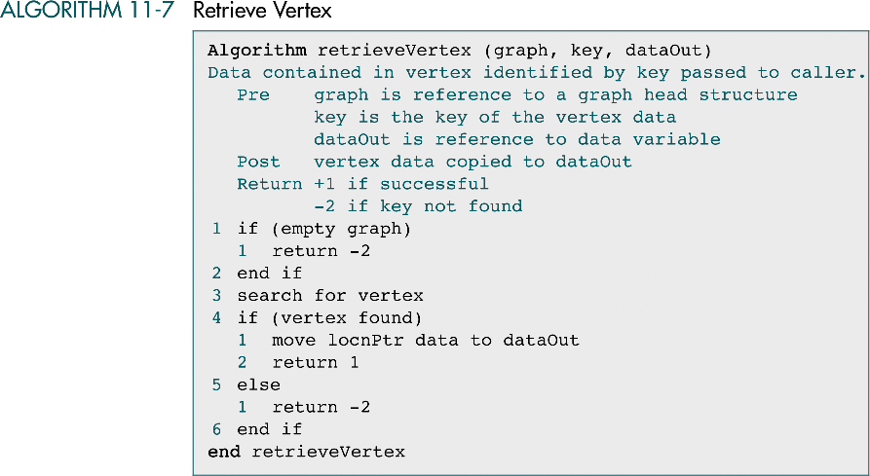

Slide 44
Depth-first Traversal
Visits all of the vertices in a graph by processing a vertex and all of its descendents before processing an adjacent vertex
Using recursion or a stack
When we reach a vertex, we push it into a stack
Then pop the stack, process the vertex, and push all of its adjacent vertices into the stack
A processed flag
We must ensure that each vertex is processed only once
When we begin the traversal, we set the processed flag to 0
When we push a vertex into the stack, we set to 1
When we process the vertex, we set to 2

Slide 45
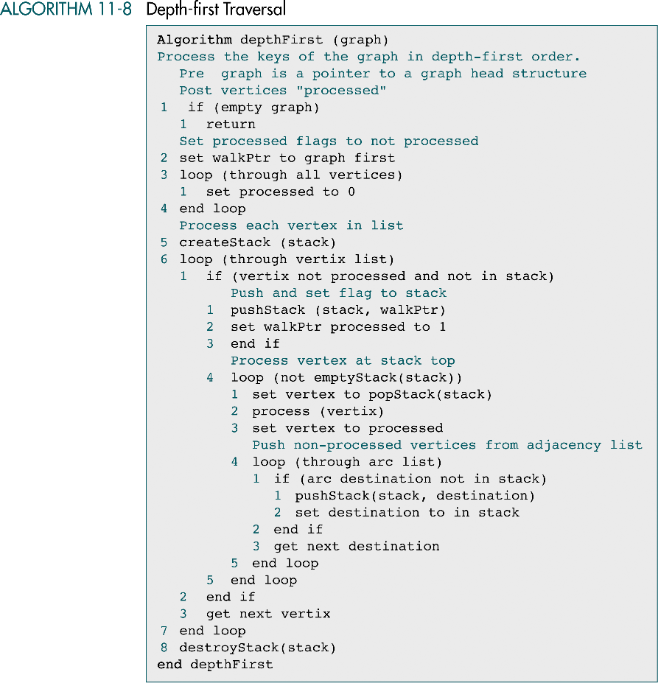

Slide 46
(continued)

Slide 47
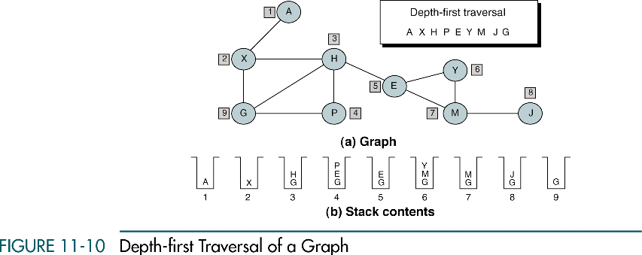

Slide 48
Breadth-first Traversal
Processes a vertex and then processes all of its adjacent vertices
Using a queue

Slide 49
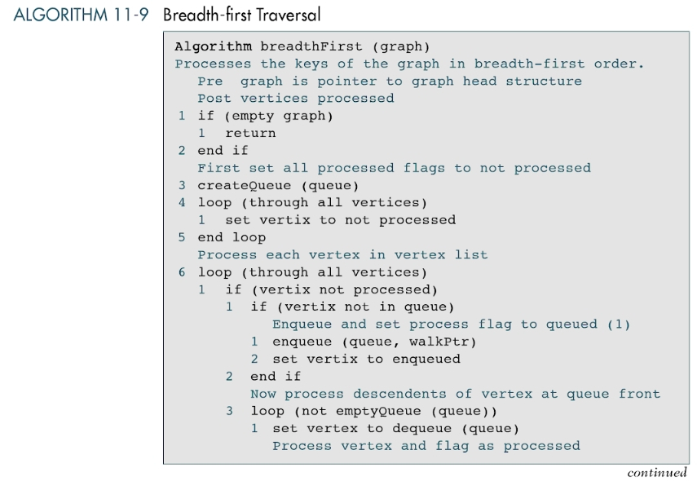

Slide 50
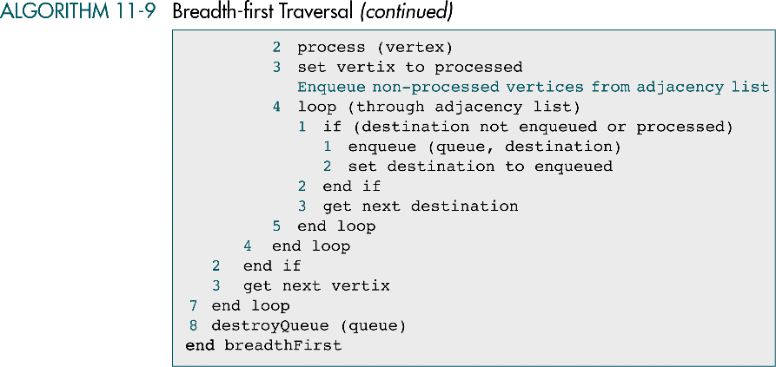

Slide 51
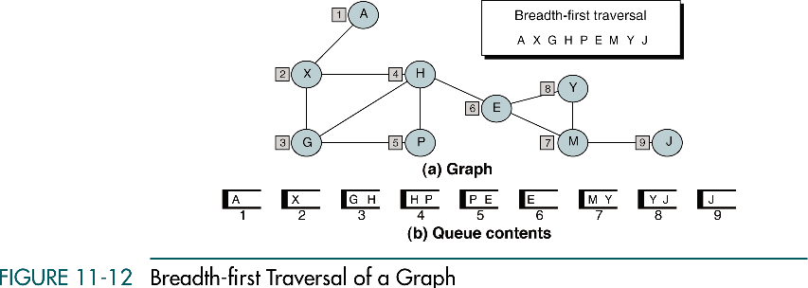

Slide 52
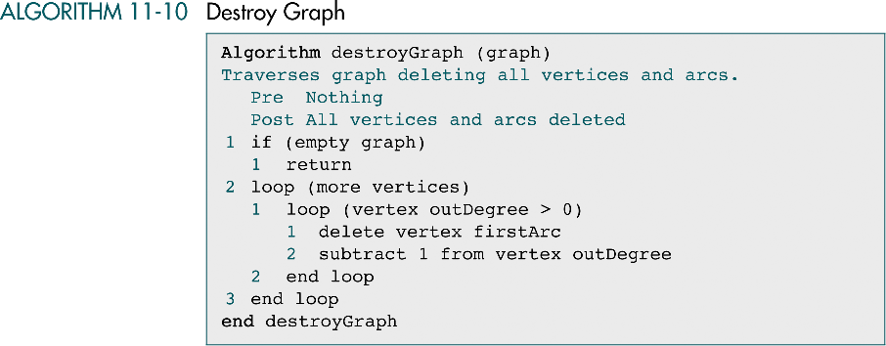
Destroy Graph

Slide 53
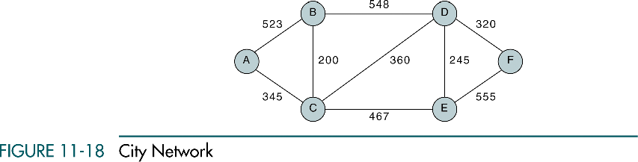
Networks
A network is a graph whose lines are weighted
A.K.A a weighted graph
The meaning of the weights depends on the application
Ex) In an airline, routes between cities that it serves.
The vertices represent the cities and the edge a route between two cities
The edge’s weight could represent the miles between the two cities or the price of the flight
The mileage between the cities

Slide 54
Networks
The weight is an attribute of an edge, it is stored in the structure that contains the edge
In an adjacency matrix, the weight is stored as the intersection value
In an adjacency list, it is stored as the value in the adjacency linked list

Slide 55
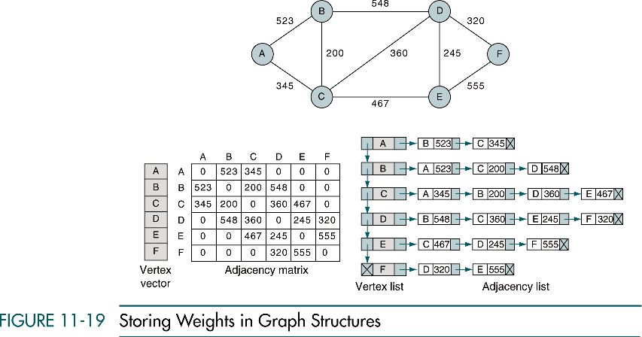

Slide 56
Networks
Two graph applications that process networks
Minimum Spanning Tree
Shortest Path Algorithm

Slide 57
Minimum Spanning Tree
A spanning tree is a tree that contains all of the vertices in the graph
We can derive one or more spanning trees from a connected graph
The minimum spanning tree of a network such that the sum of its weights is guaranteed to be minimal
If the weights in the network are unique, there is only one minimum spanning tree
If there are duplicate weights, there may be one or more minimum spanning trees

Slide 58
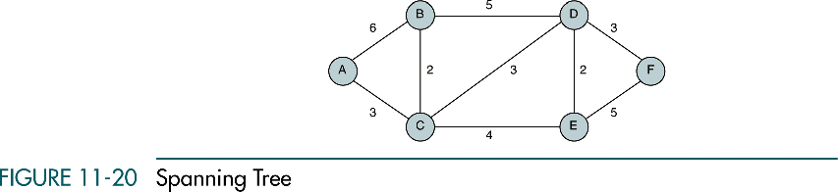
Minimum Spanning Tree
(original graph)

Slide 59
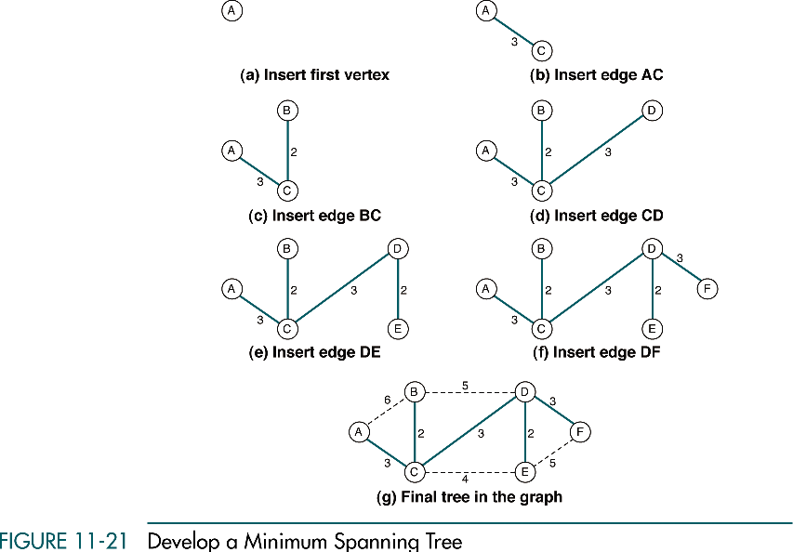
We can start with any vertex

Slide 60
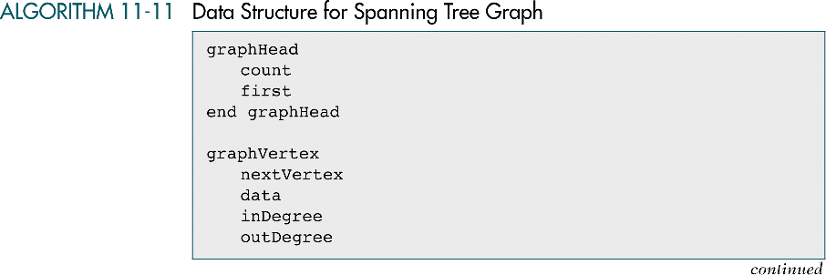
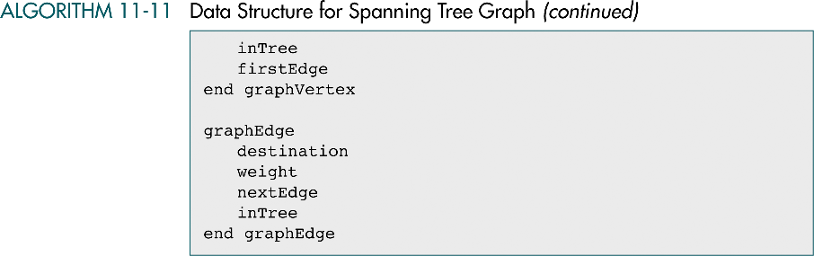
`
A Boolean flag indicating that the vertex has been inserted into the spanning tree
`
`

Slide 61
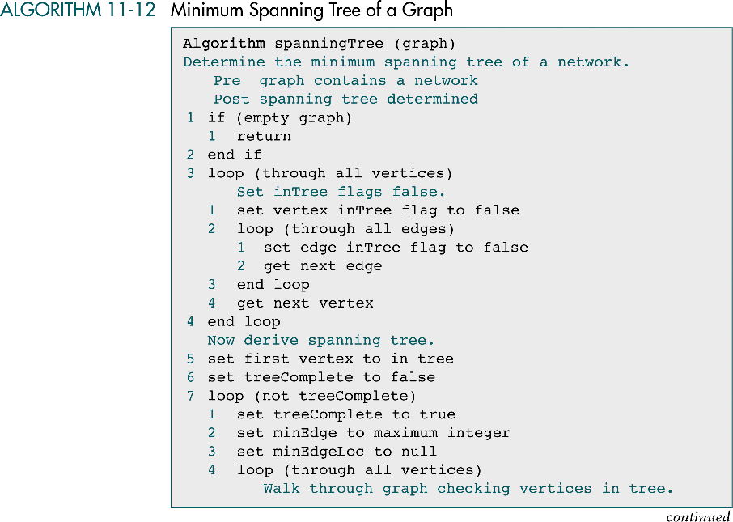

Slide 62
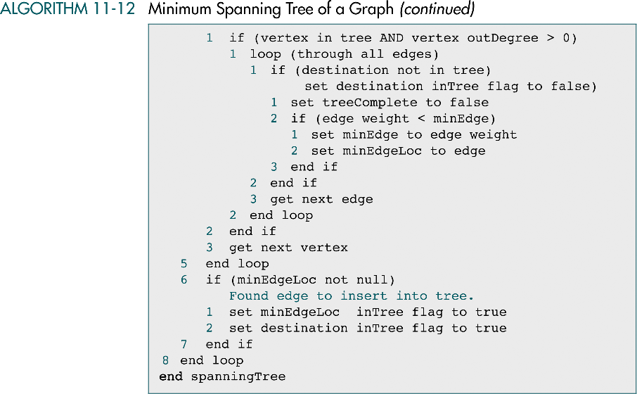

Slide 63
Shortest Path Algorithm
Dijkstra’s shortest path algorithm
Is used to find the shortest path between any two nodes in a graph
General steps:
Insert the first vertex into the tree
From every vertex already in the tree, examine the total path length to all adjacent vertices not in the tree. Select the edge with the minimum total path weight and insert it into the tree
Repeat step 2 until all vertices into the tree
pathLength
We need to add one more field to the vertex structure, a total path length to the vertex

Slide 64
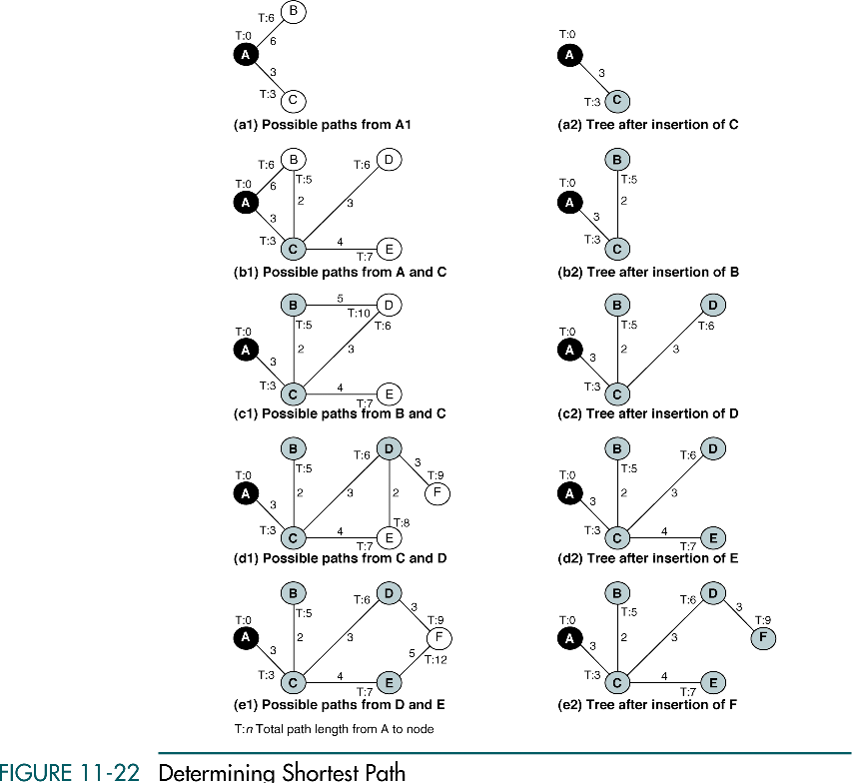

Slide 65
(continued)

Slide 66
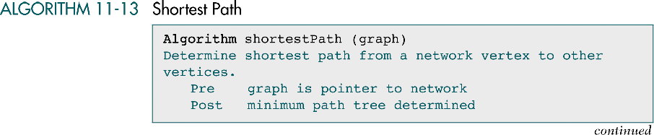
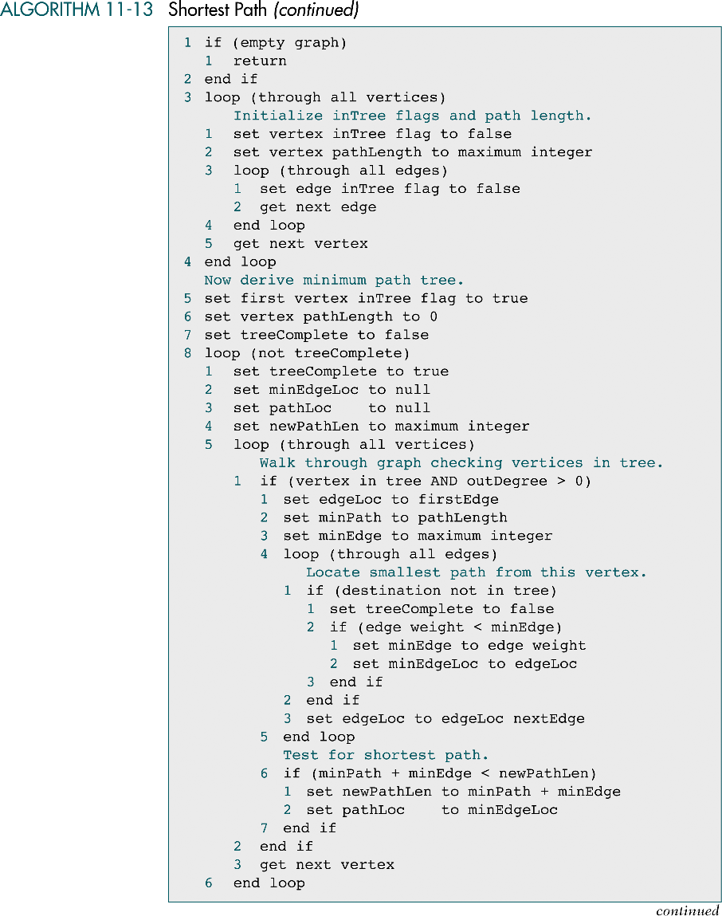

Slide 68
